Slide 1

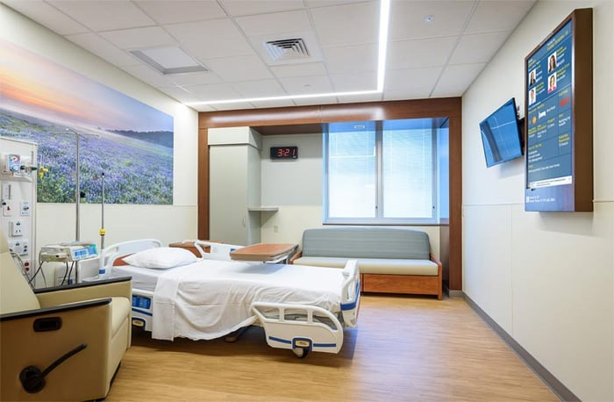
Autonomous Hospital Room Sanitization and Drug Delivery Rover Robot
MCE 592
&
COE 596
Capstone Design II
Advised by:
Dr. Joe Tekli
Presented by:
Abbas Abdallah
Hasan Bazzi
Mohamad Jaber
Mohammad Nasser

Slide 2



Table of Contents
Motivation
Why is the proposed idea a source of interest?
``
Our Implementation
Based on literature, what final design we will go for?
Hardware Design
Mechanical and Electrical aspect of the system
Software Design
Programming part of the system
Limitations and Constraints
Under what conditions can the system operate?
Alignment with SDGs
How is the proposed solution supporting SDG goals?

Slide 3


Motivation

Slide 4
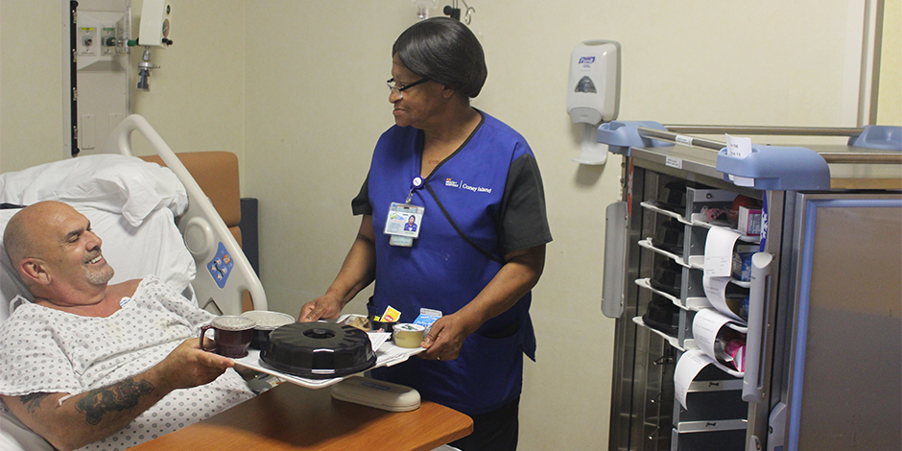
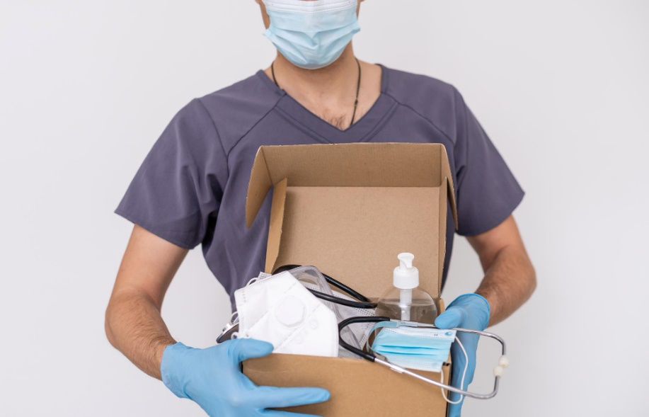
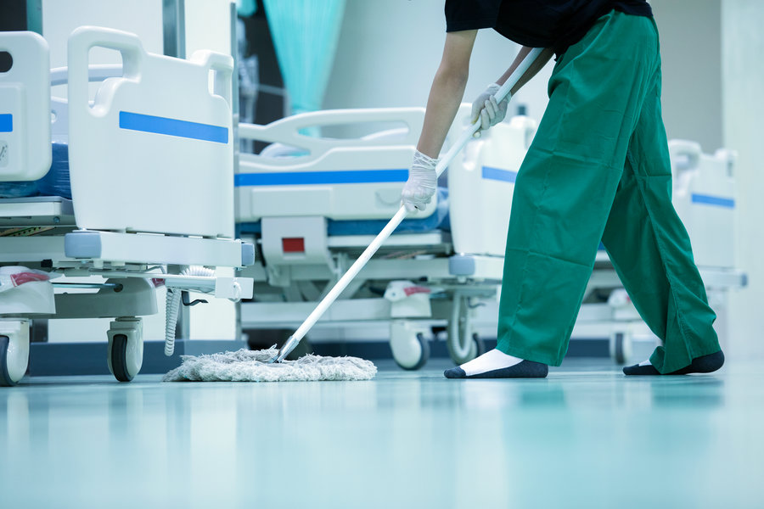
Motivation
An autonomous robot that can handle simple, yet necessary daily tasks in hospitals
Fig. 1. Food delivery in hospitals [1]
Fig. 2. Medical supplies delivery [2]
Fig. 3. Hospital cleaning [3]

Slide 5
Our Implementation

Slide 6
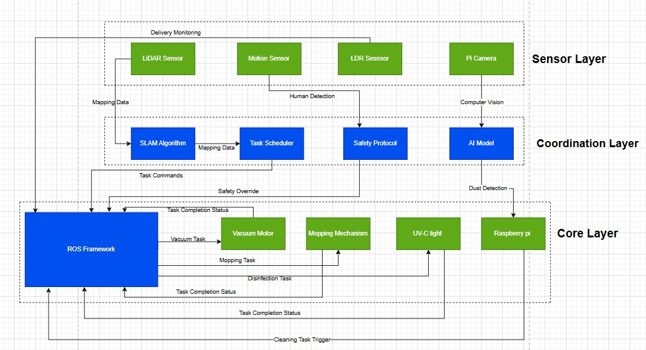
System’s Architecture
Fig. 4. System’s Architecture

Slide 7
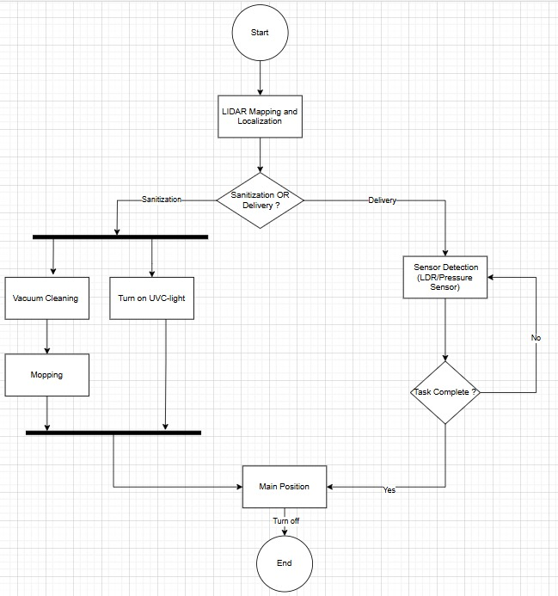
System’s Activity Diagram
Fig. 5. System’s Activity Diagram

Slide 8
Hardware Design

Slide 9
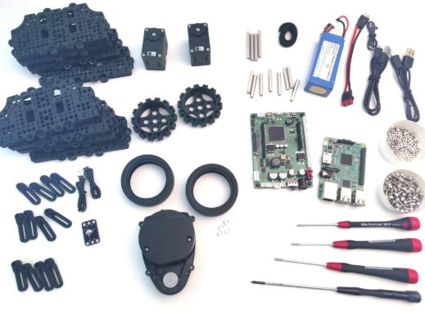

1. Robot Chassis:
DC motors
plates
Lithium battery
wheels
RPi 4 model B
2D LiDAR
Fig. 6. Turtlebot3 burger’s icon
Fig. 7. Turtlebot3 burger hardware components
Open CR

Slide 10
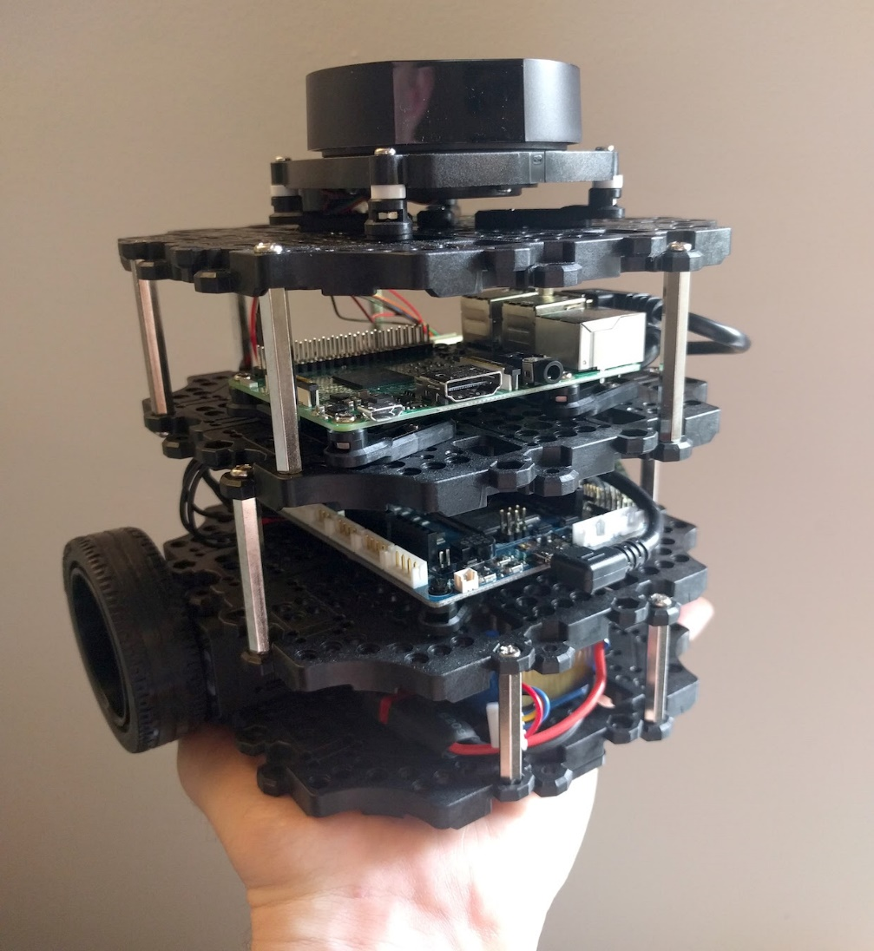
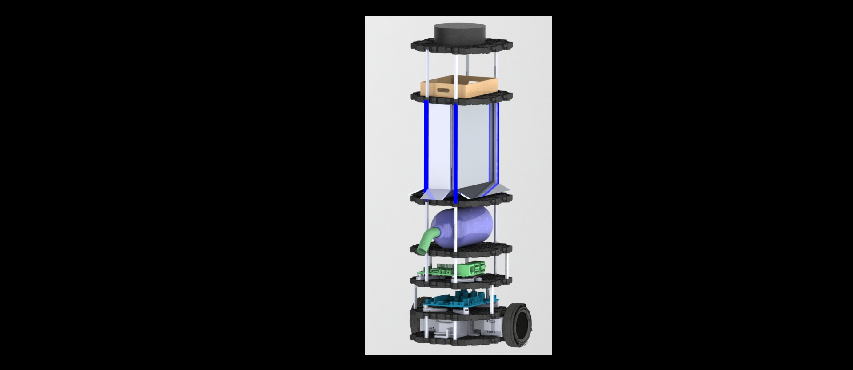
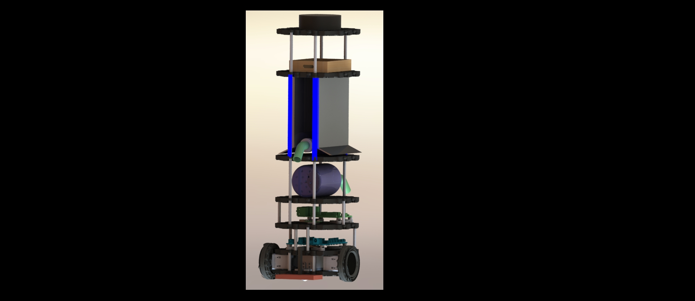
1. Robot Chassis:
Fig. 8 Turtlebot3 burger assembly
Fig. 9 System’s assembly done in FYP1

Slide 11
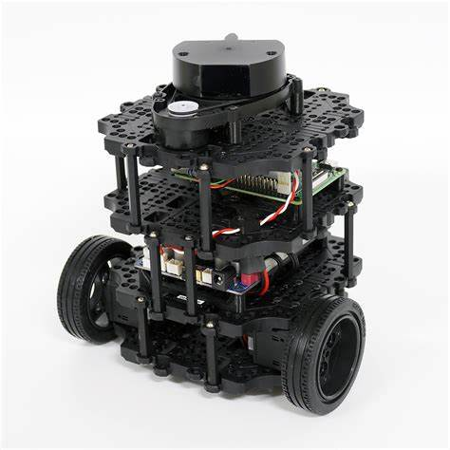
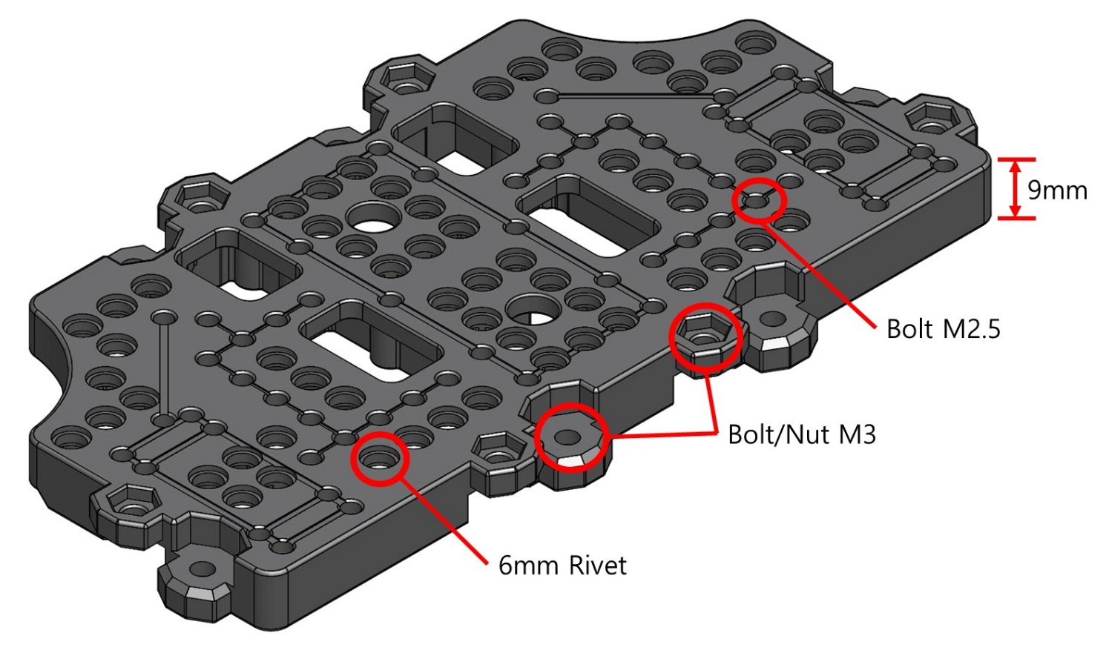
2. Mechanical Design Adjustments:
missing!
Fig. 10 Components availability constraints
Fig. 11 Plate design constraints

Slide 12

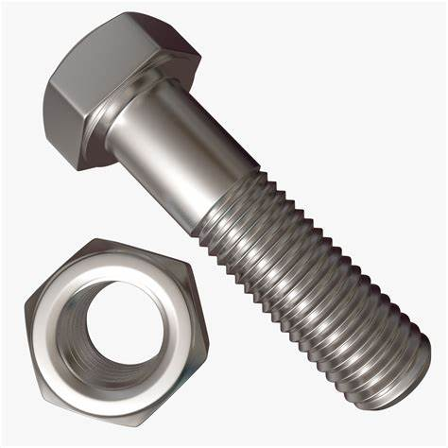
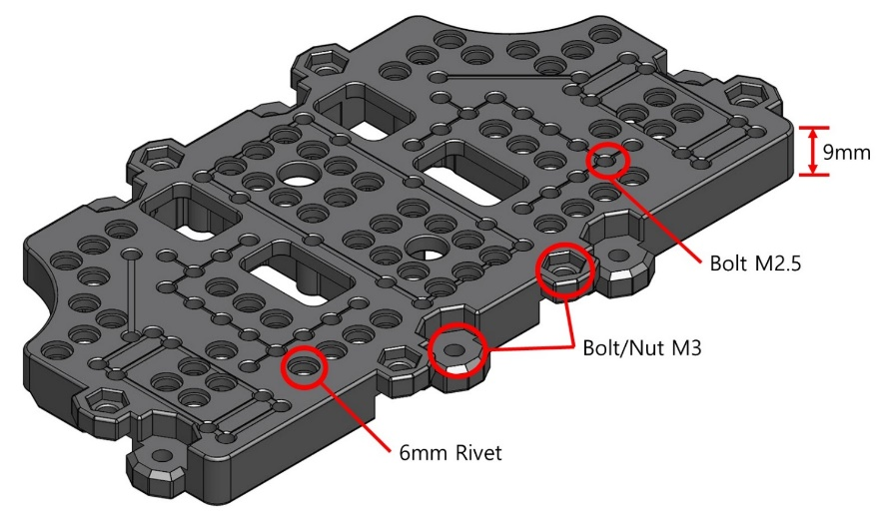

2. Mechanical Design Adjustments:
Use them for plate supports
Fig. 12 Bolts and nuts
Fig. 13 Positions to place supports
Video 1 Plate addition demonstration
Fig. 14 Designed plate addition supports

Slide 13

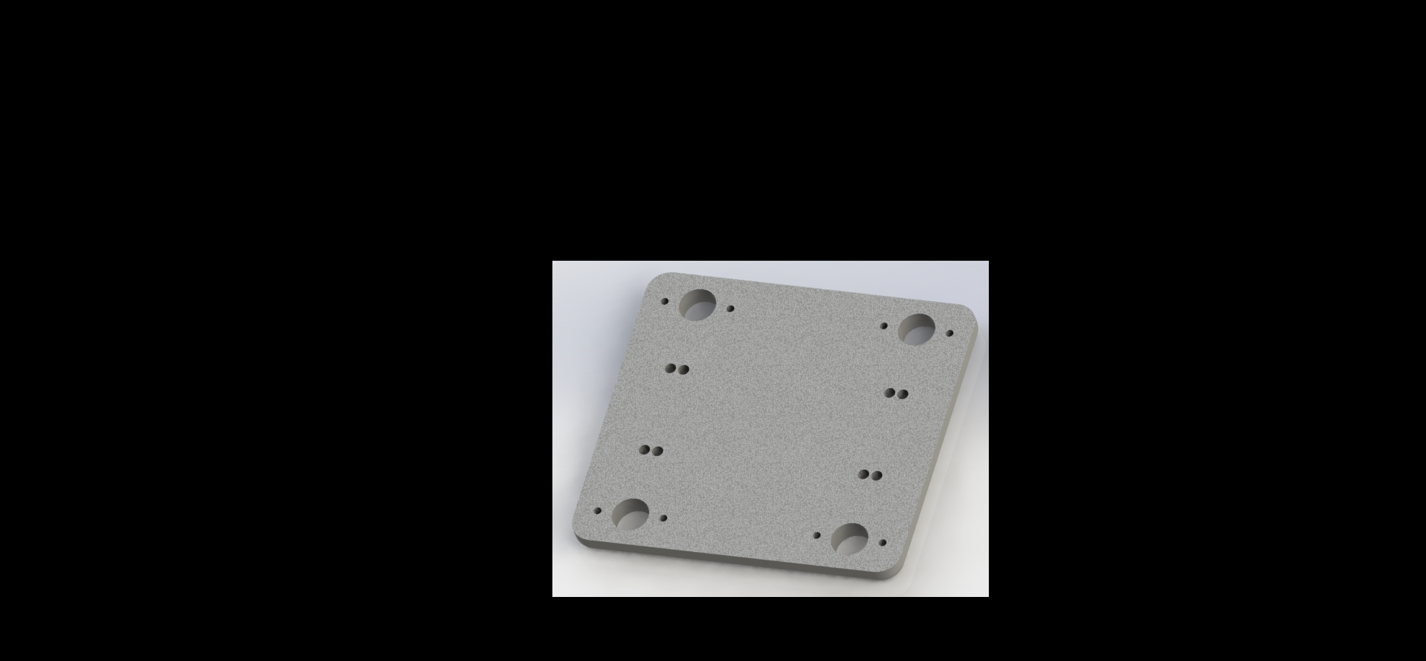
2. Mechanical Design Adjustments:
Fig. 15 plate design
Video 2 System’s Assembly

Slide 14
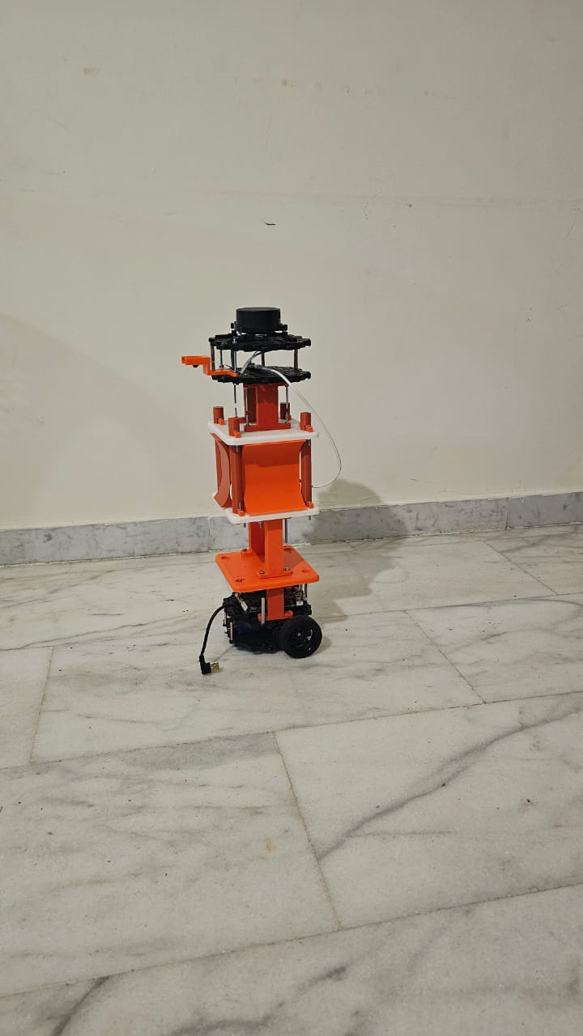
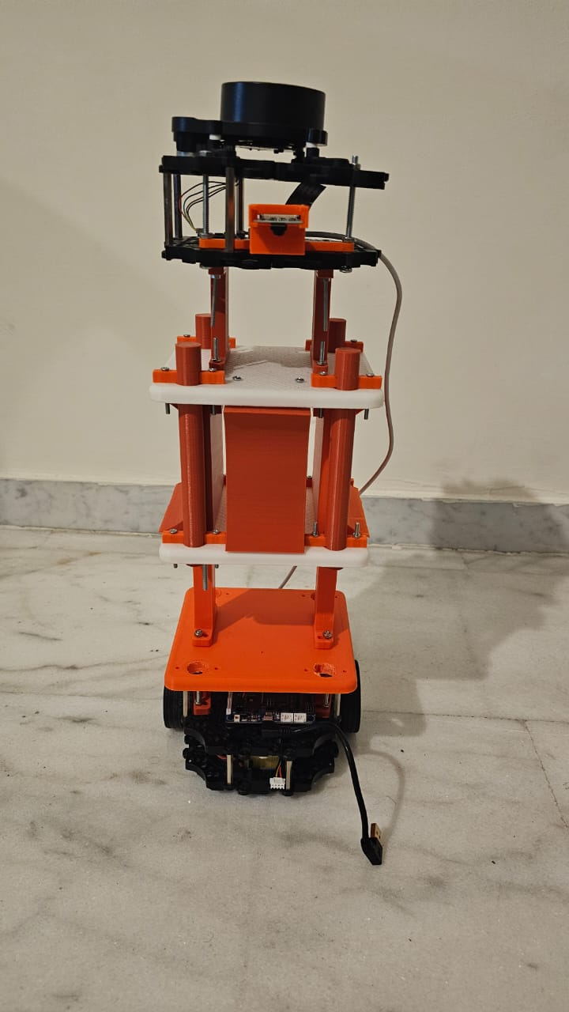
2. Mechanical Design Adjustments:
Fig. 16 Complete Assembly

Slide 15
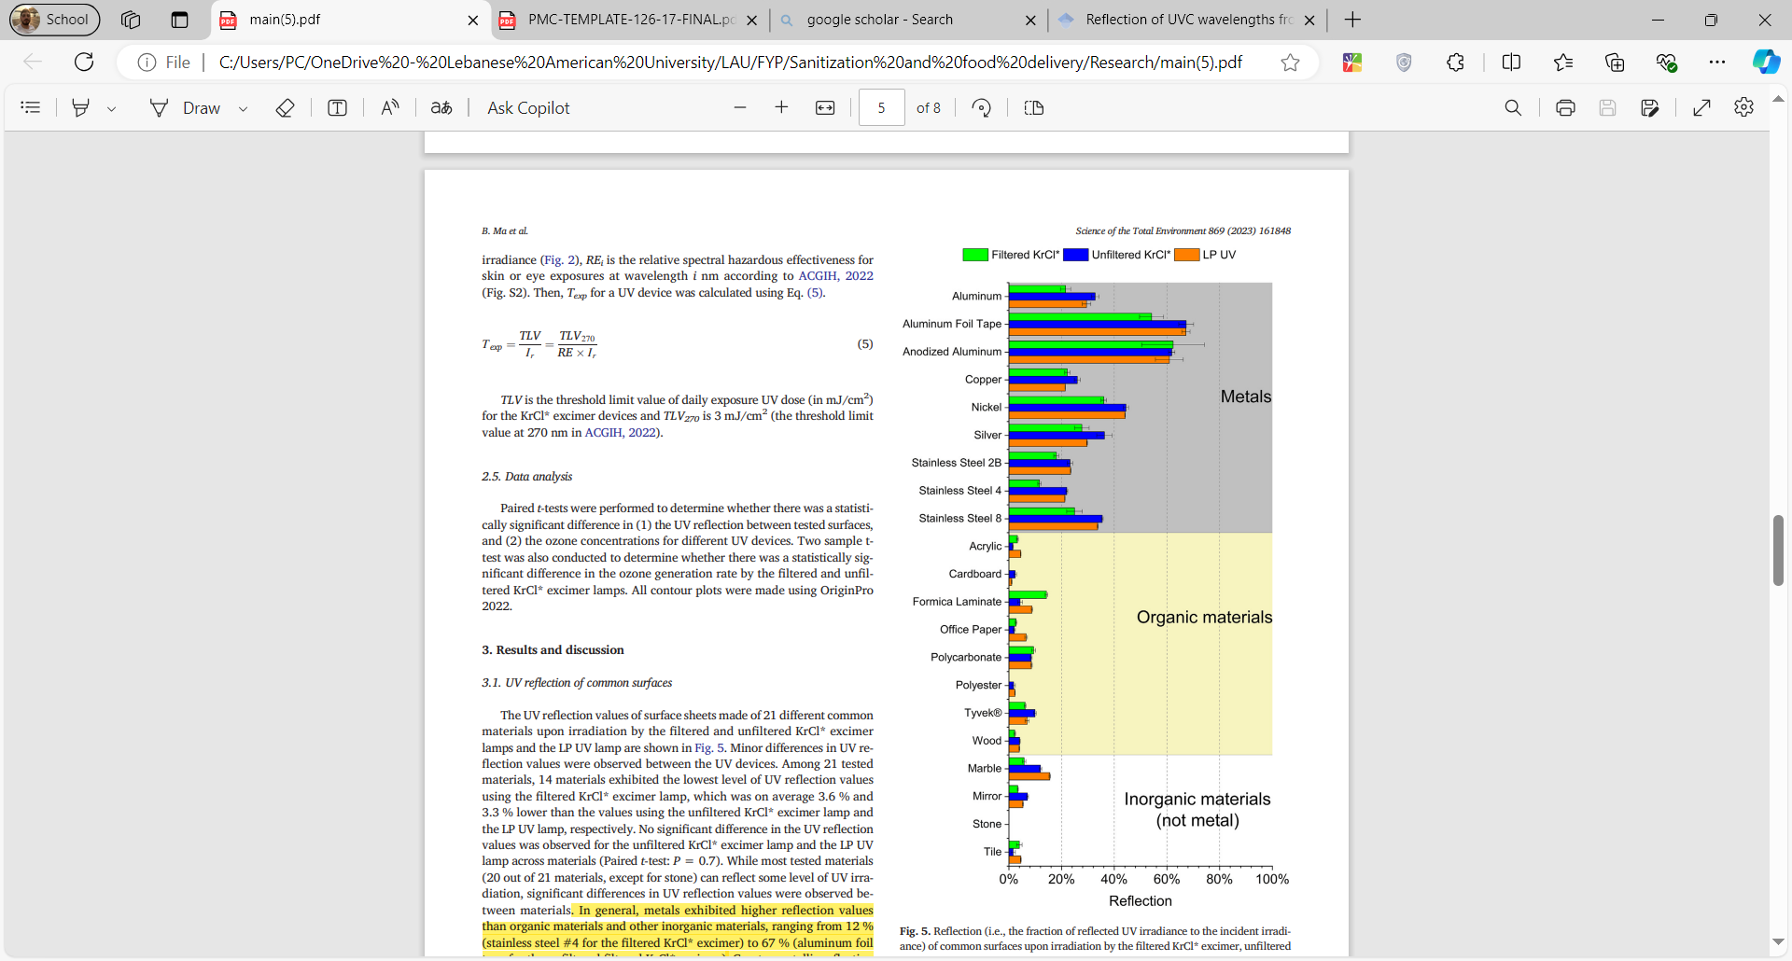
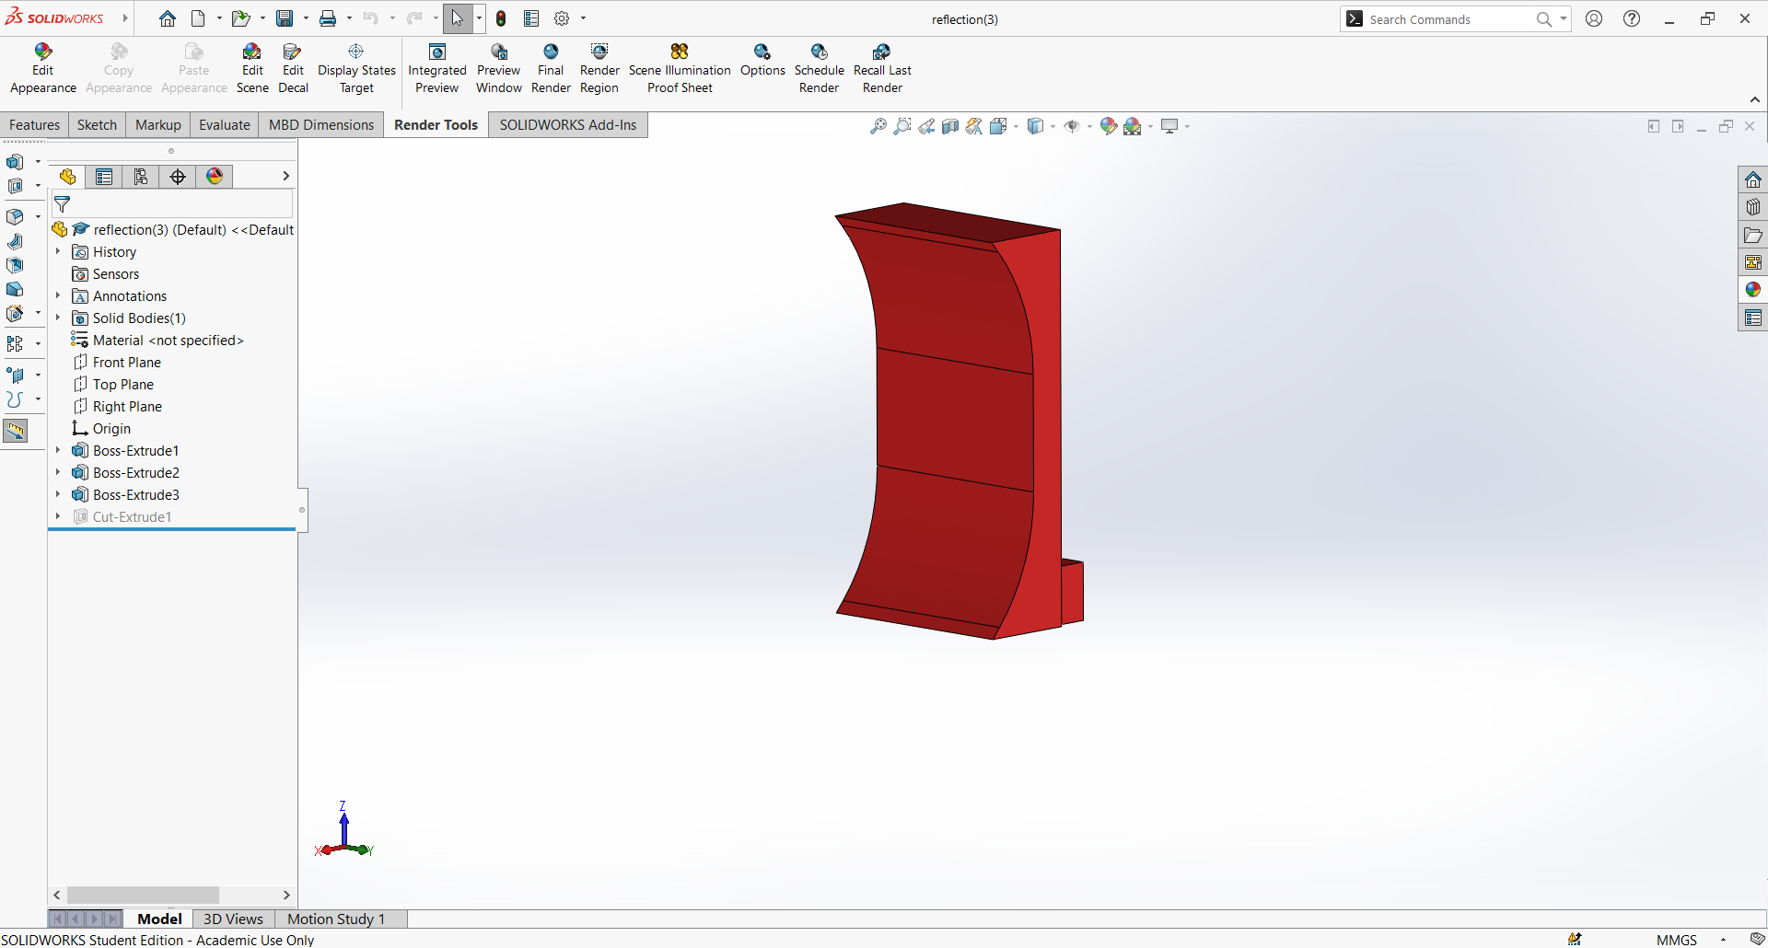
2. UV-C LEDs and Reflective Surfaces:
Fig. 18 Designed material for reflection
Fig. 17 Reflection percentage of different materials

Slide 16
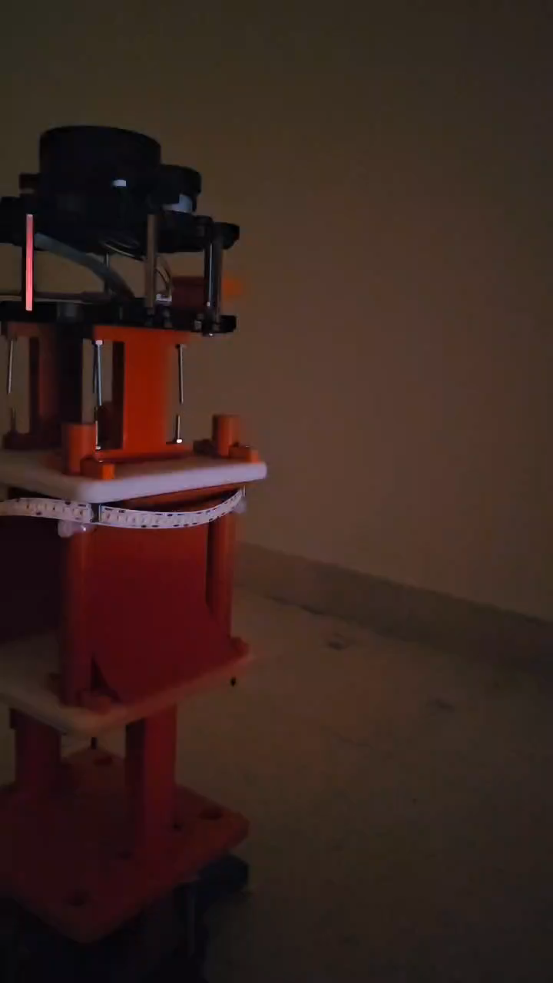
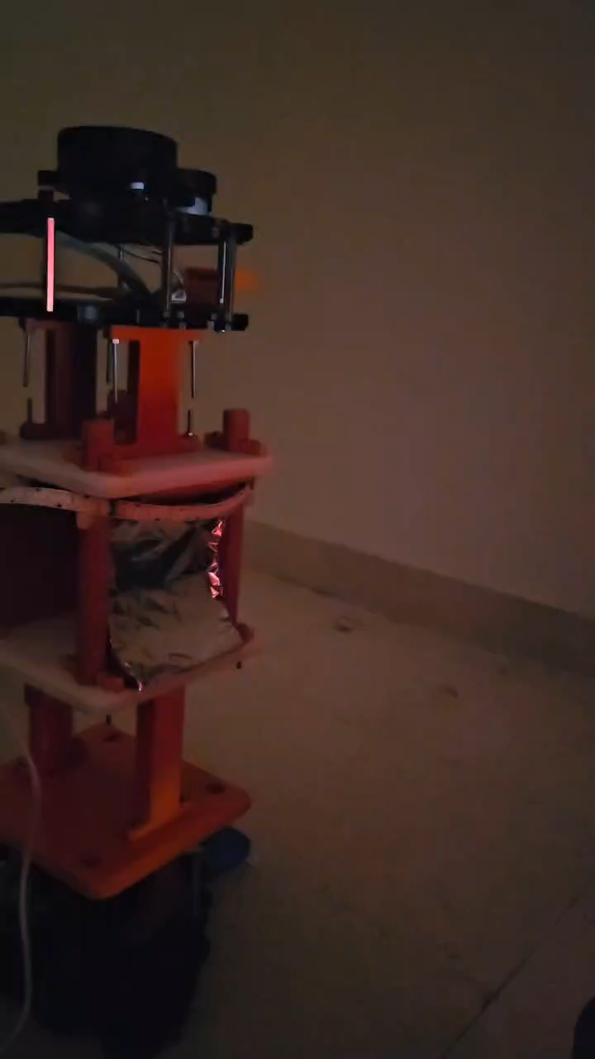
2. Mechanical Design Adjustments:
Video 3 Lighting without reflective materials
Video 4 Lighting with reflective material

Slide 17
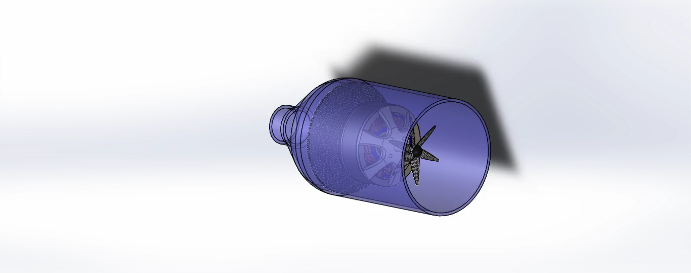
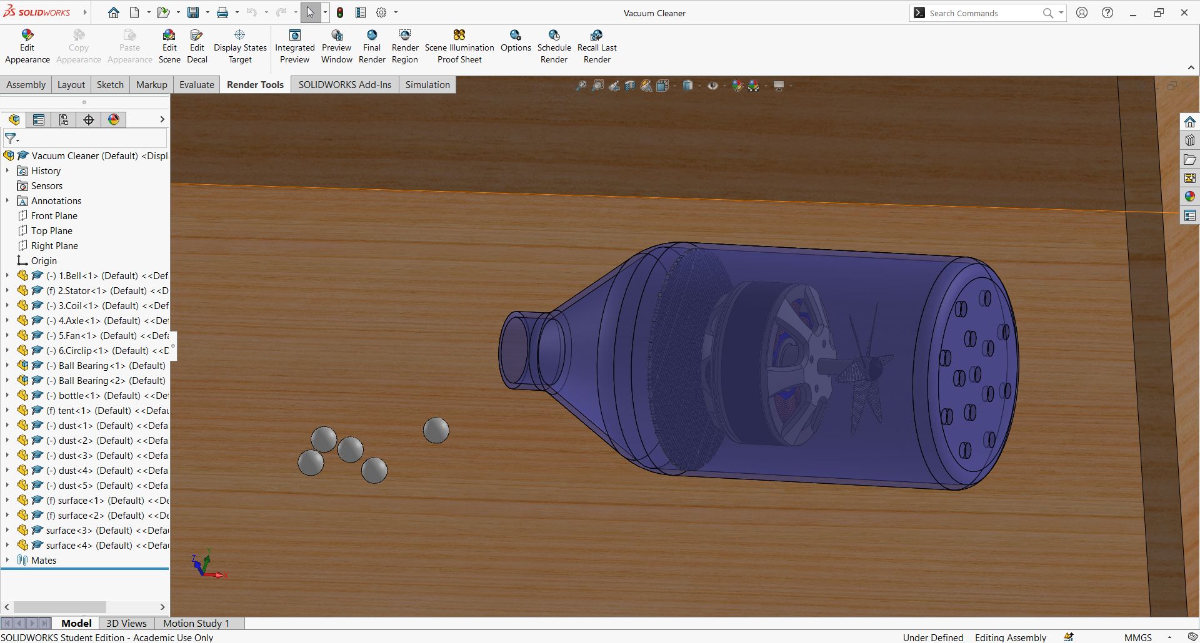
3. Vacuum Cleaner:
Video 5 Vacuum cleaner working principle
Fig. 19 Vacuum cleaner’s CAD model

Slide 18
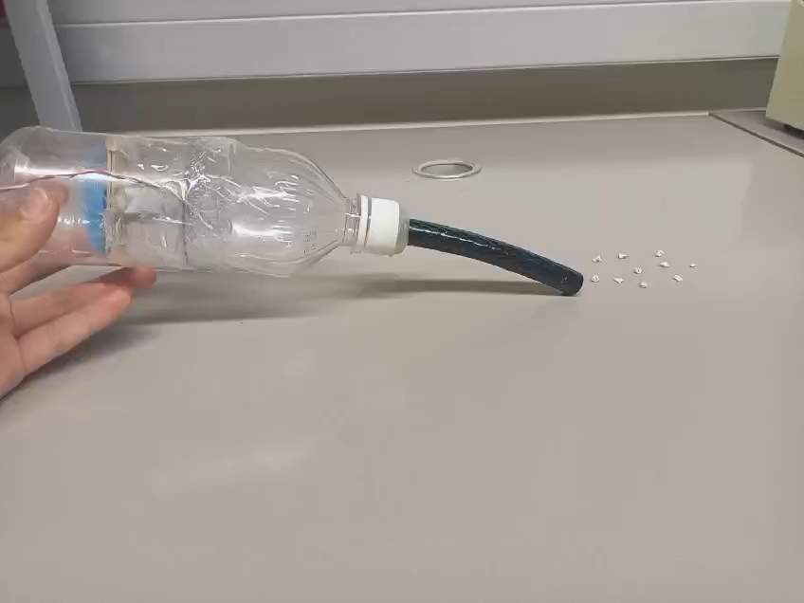
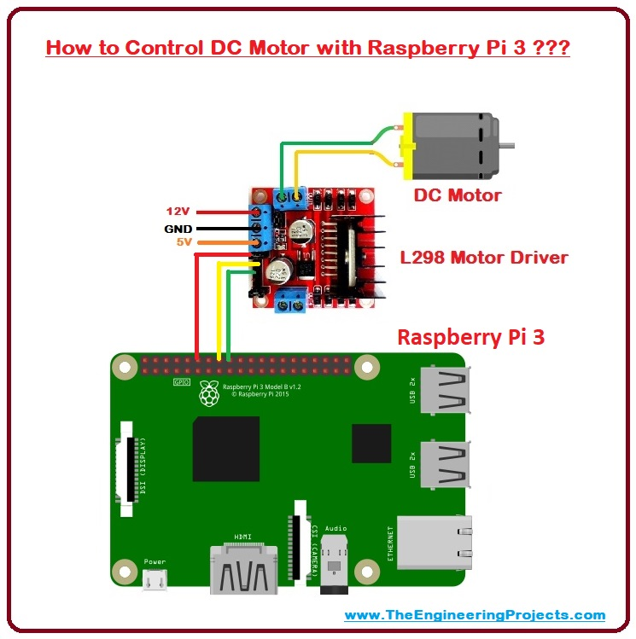
3. Vacuum Cleaner:
12V
GND
5V
Video 6 Vacuum cleaner hardware testing
Figure 20 Vacuum cleaner electrical circuit connections

Slide 19
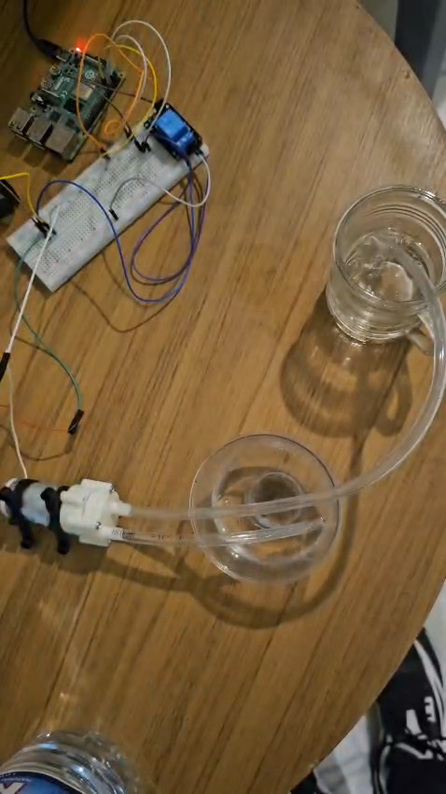
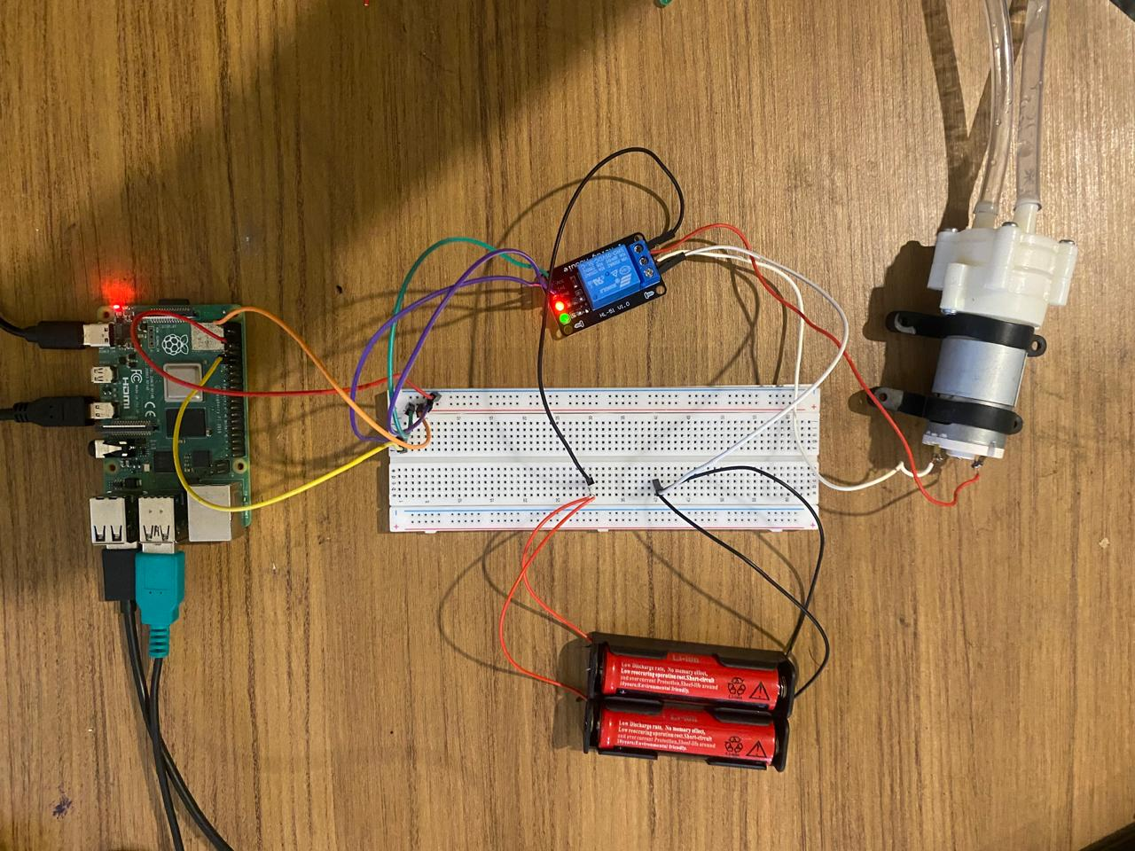
4. Disinfection Solution Pump:
Video 7 Pump hardware testing
Figure 21 Pump electrical circuitry

Slide 20
Software Implementation

Slide 21
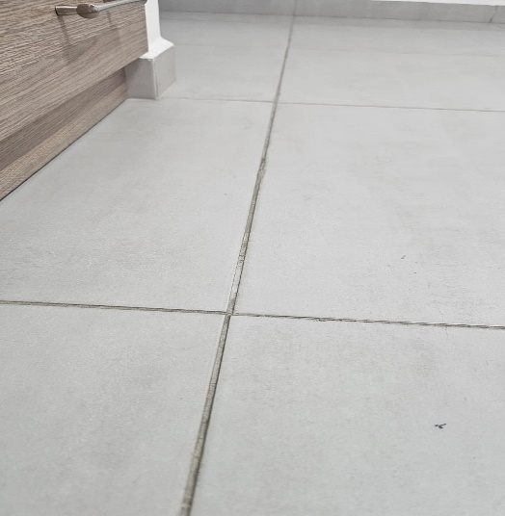
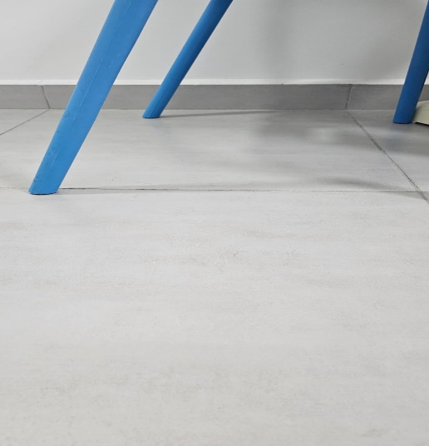
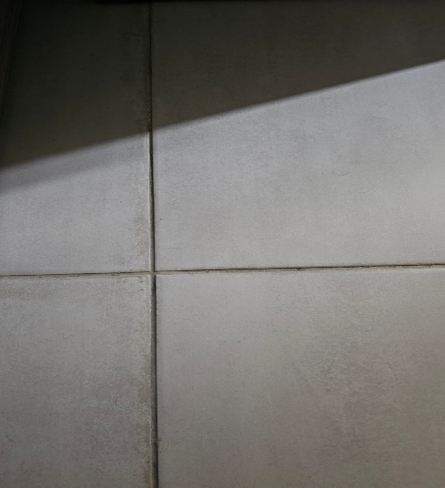
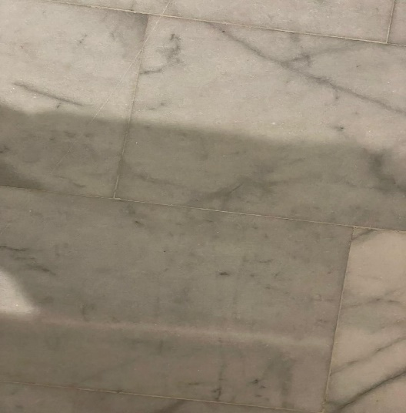
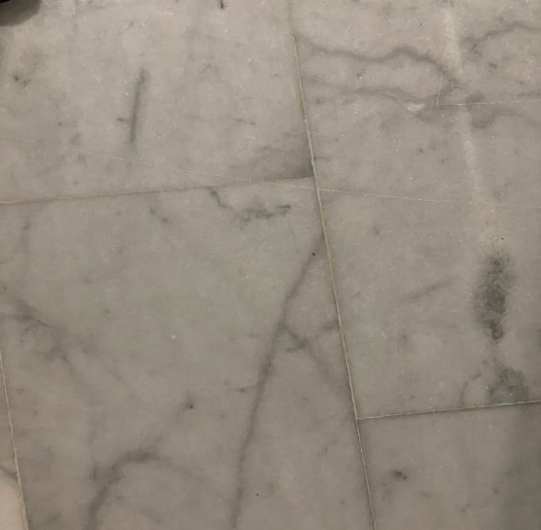
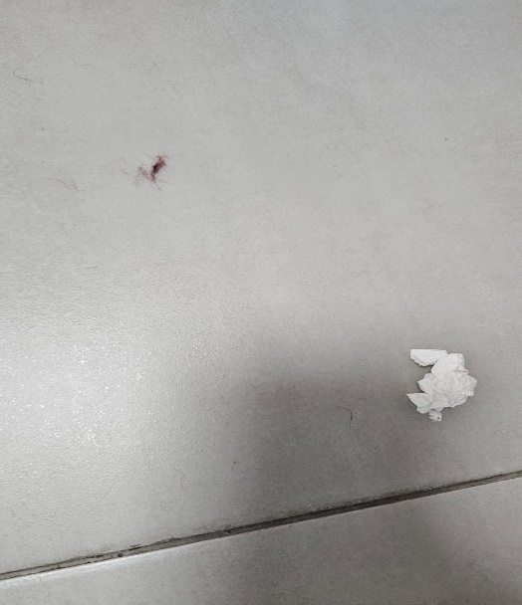
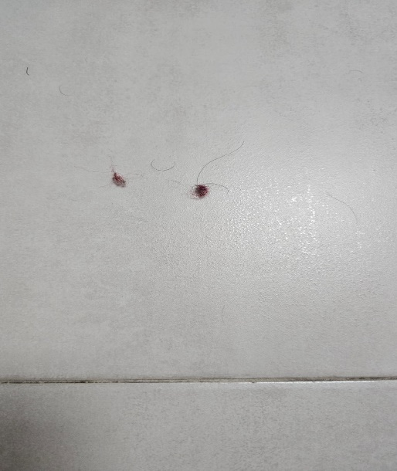
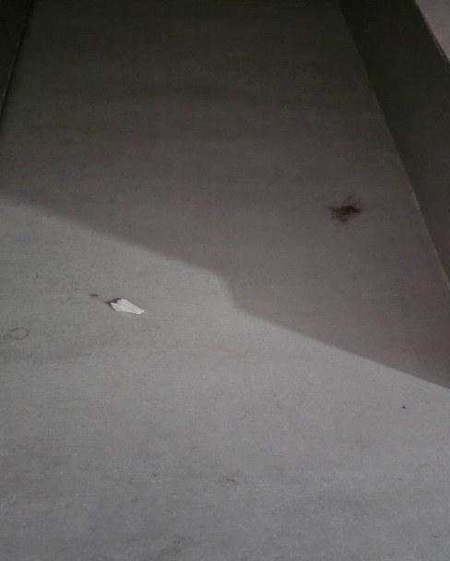
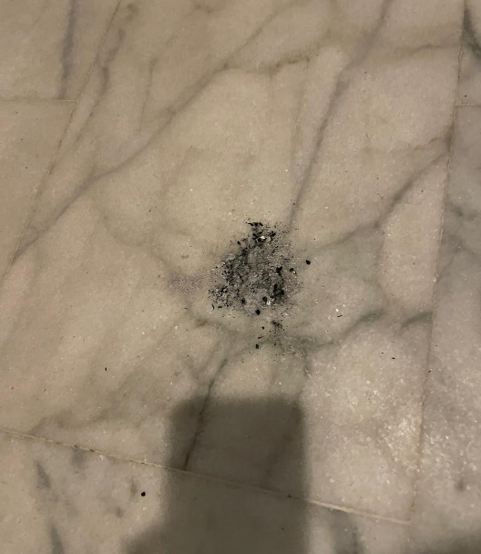
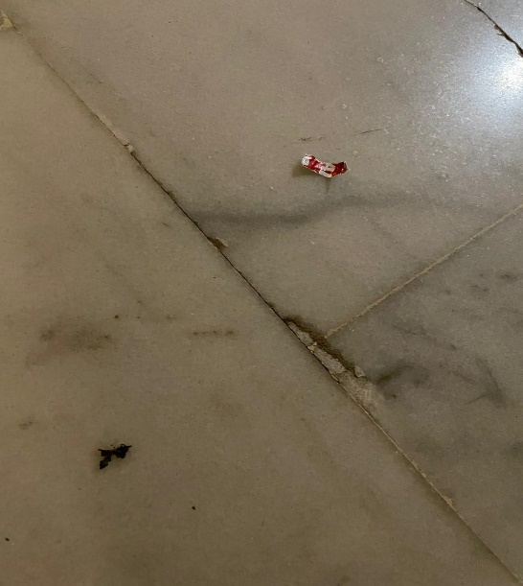
5. Computer Vision and AI Model:
5.1. Data Collection
Figure 22 Samples of collected data

Slide 22
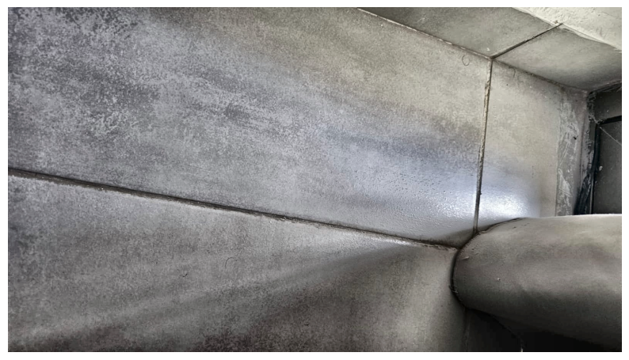

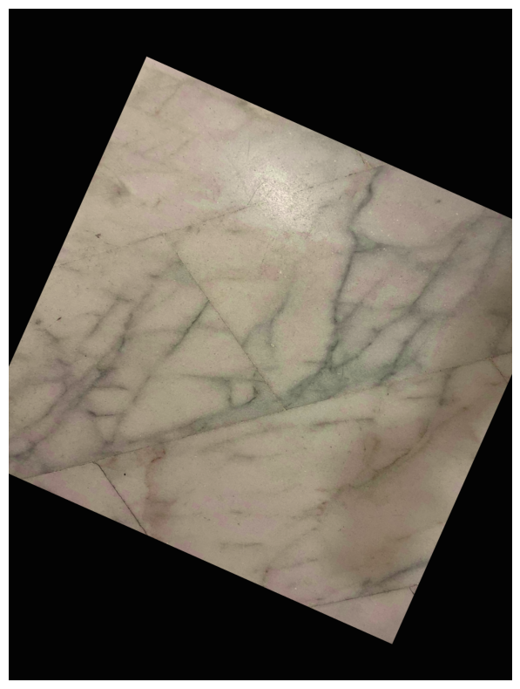
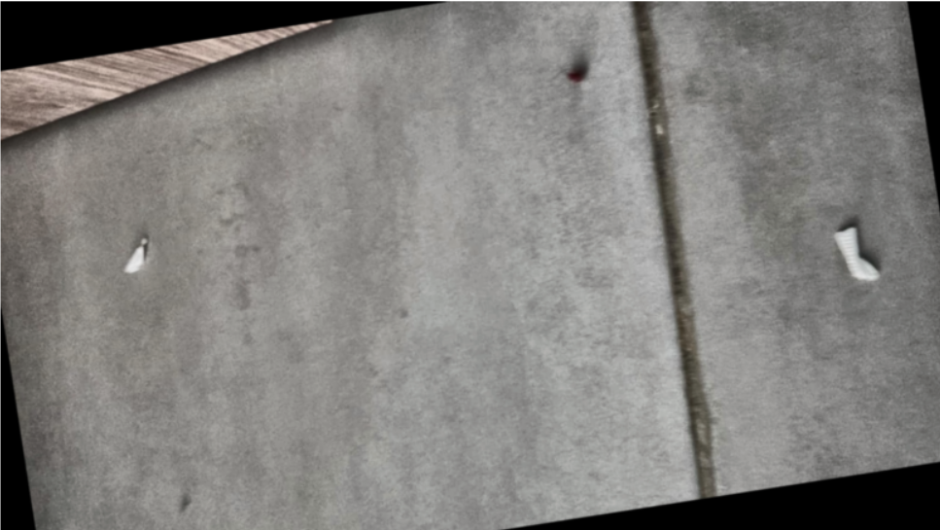
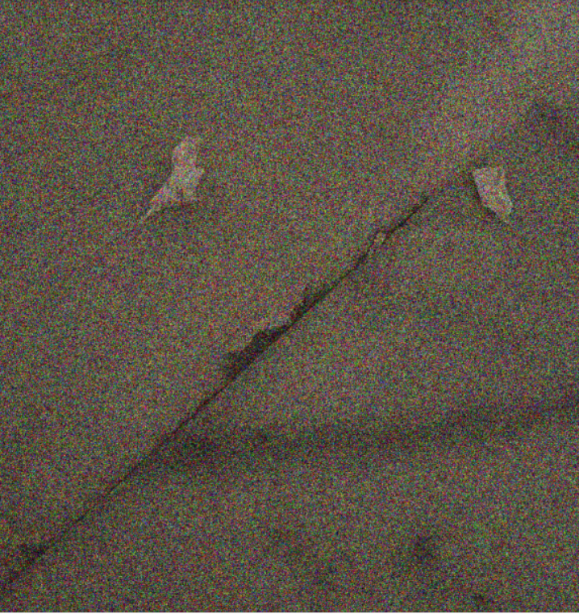
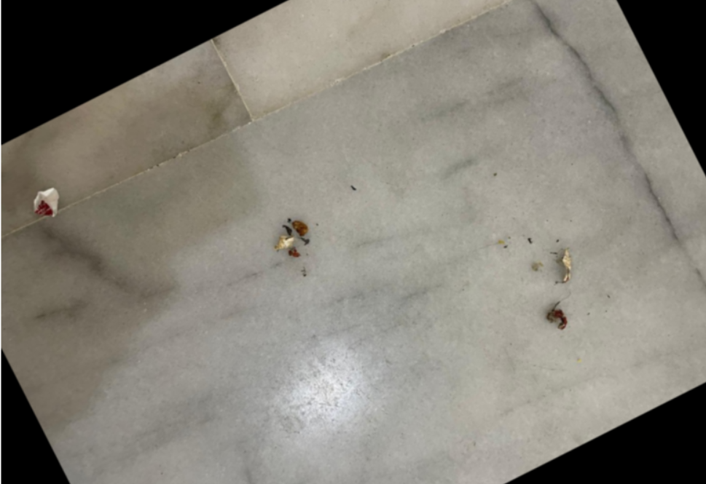
5. Computer Vision and AI Model:
5.2. Data Augmentation
Figure 23 Samples of augmented data

Slide 23
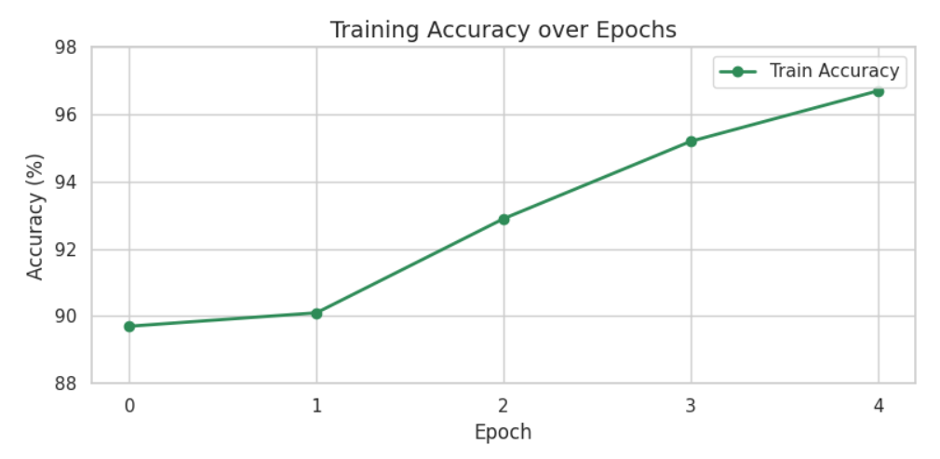
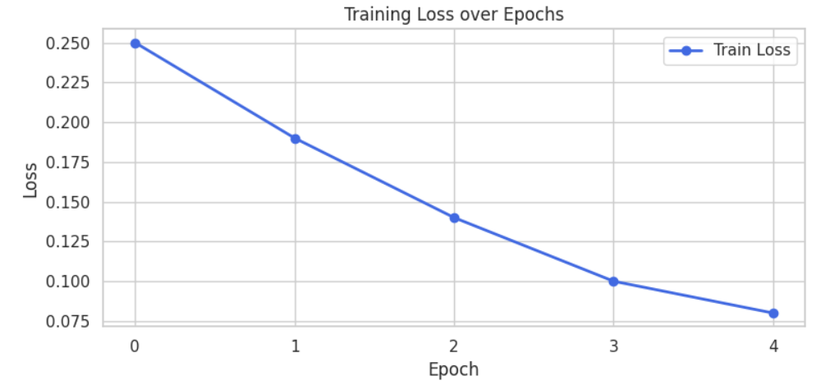
5. Computer Vision and AI Model:
5.3. Model’s Evaluation
Figure 24 Tensorboard evolution of training accuracy
Figure 25 Tensorboard evolution of loss
Test Accuracy: 96%
Precision: 96%
Recall: 95%
F1-score: 95%

Slide 24
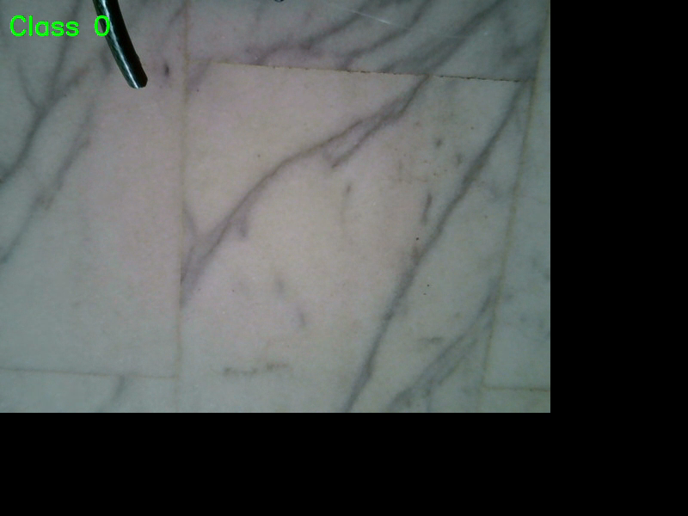
5. Computer Vision and AI Model:
5.4. Real Time CV Classification
Video 8 Computer vision clean tiles classifier

Slide 25
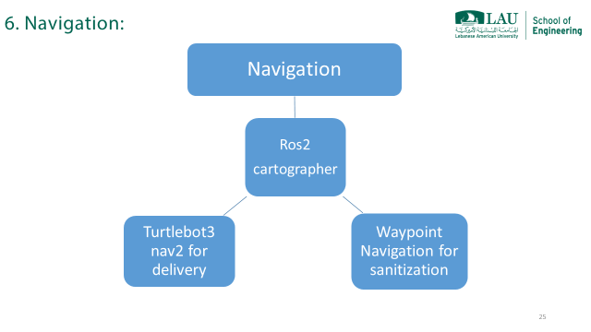

Slide 26
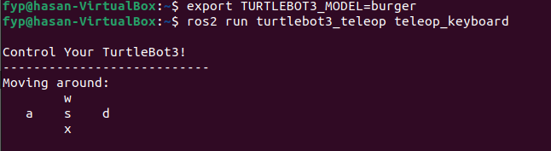
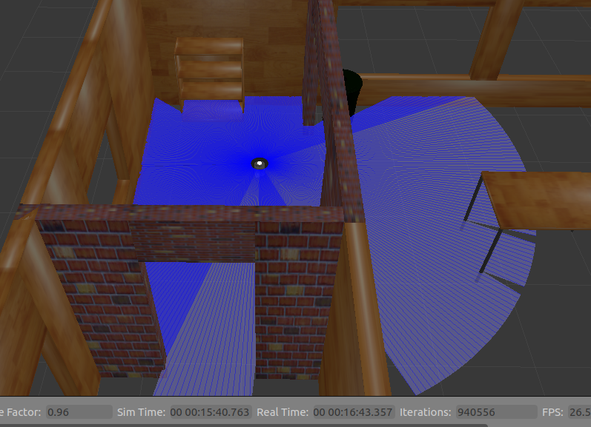
6. Navigation:
6.1. Manual Exploration of the Map
Figure 26 Keyboard controls for turtlebot3
Figure 27 Moving the robot across the environment

Slide 27
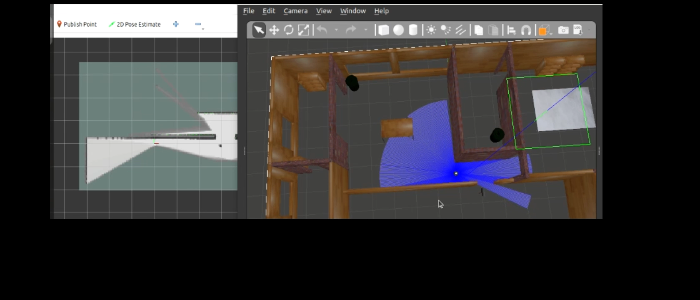
6. Navigation:
6.1. Manual Exploration of the Map
Video 9 Manual movement of the turtlebot

Slide 28
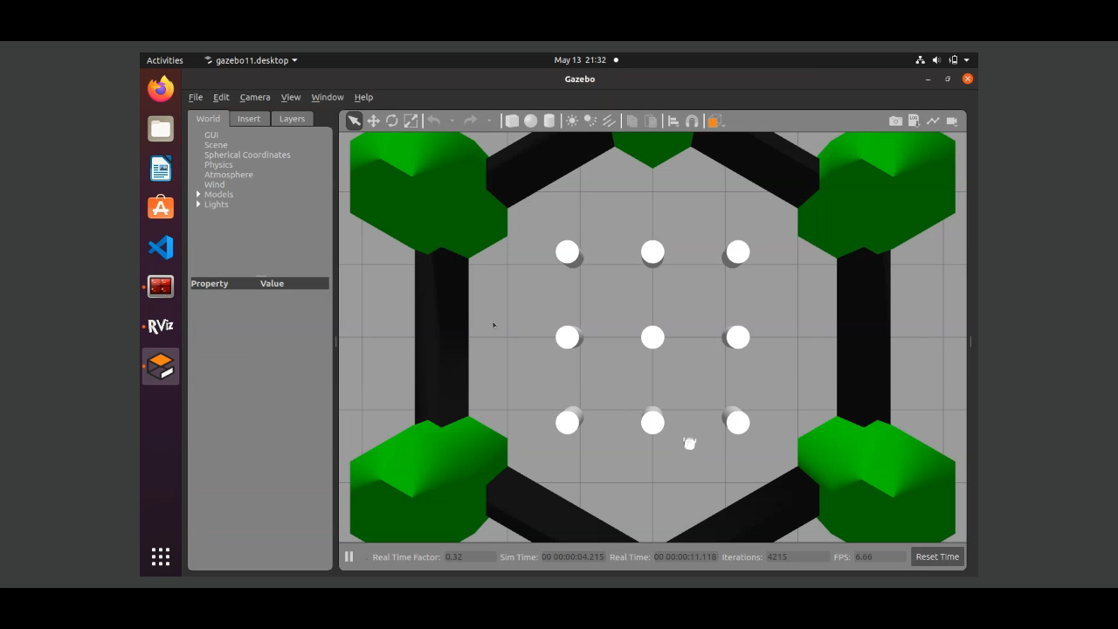

6. Navigation:
6.2. Autonomous Exploration of the Map
Video 10 RVIZ of the bump and go algorithm
Video 11 Gazebo of the bump and go algorithm

Slide 29


6. Navigation:
6.3. Autonomous Exploration of the Map
Figure 28 Bump and go in the house map
Figure 29 Generated map of the house

Slide 30

6. Navigation:
6.4. Autonomous Nav2 Goal
Video 12 Cartographer navigation

Slide 31



6. Navigation:
6.5. Autonomous Follow of Trajectory
Video 13 Navigation testing of the robot

Slide 32

Limitations and Constraints

Slide 33
Alignment with SDGs:
Functional Constraints
Autonomous Operation
The robot works autonomously, but receives instructions on where to go and what to do from hospital staff.
Navigation
The robot is already provided with the map of the environment, and it only does navigation.
Path Planning
No specific path planning algorithm is done, the coordinates of the path the robot should move in is done for each separate room and the robot follows the path provided for each room.
Limited Delivery
The medications to be delivered are to be determined by the hospital staff.
The hospital staff manually put the drugs or the food to be delivered, and those delivered items are assumed to be taken successfully.

Slide 34
Alignment with SDGs:
Non-Functional Constrains
Environment
The robot is operating in static environments.
We assume that all the obstacles are detected by the 2D LiDAR sensor.
The doors are connected by IoT to the robot by which they automatically open when the robot reaches the room, and close when the robot leaves.
Weight
The robot should be lightweight (<12kg).
Safety
The UVC LEDs should be operating in environments where no humans are present.
The robot automatically turns off the UVC LEDs if a human is detected.
Chemical Liquids used for spraying/mopping are assumed to be non toxic and safe for hospital environments and materials.

Slide 35

Cost:
Components | Price (U.S. $)
TurtleBot3 Burger model | 659.30 $ + shipping fees
LED strips | 18.00 $
DC motor for vacuum cleaner | 5 $
L293D H-bridge | 1.5 $
External Batteries | 15 $
Wires | 10 $
Plastic PLA for 3D printing | 18 $/kg [46]
Pi Camera | 32 $ [47]
LDR | 1 $/piece [48]
Low LPM pump motor | 6.25 $ [49]
Tube for vacuum cleaner | 10 $
Tube for sprinkler | 10 $
2 Relay | 2 $ [50]
Total | $≈800 \$$

Slide 36
Standards and Alignment with SDGs

Slide 37
Standards:
ISO 15858:2016
UV-C equipment safety guidelines to ensure safe exposure levels for humans [15]
ISO 13485:2016
Quality management for medical devices used in drug delivery [15]
ISO 28199
Standards for evaluating surface cleanliness and disinfection effectiveness [15]
RoHS (Restriction of Hazardous Substances Directive)
To ensure that the materials used in the robot are environmentally friendly [16]

Slide 38
Alignment with SDGs:
SDG 3
Good health and well being
SDG 8
Decent work and economic growth
SDG 9
Industry, Innovation, and Infrastructure
SDG 12
Responsible consumption and production
SDG 13
Climate action

Slide 39
References:
[1] NYC Health + Hospitals, 11 September 2018. [Online]. Available: https://www.nychealthandhospitals.org/pressrelease/new-meal-delivery-system-enhances-the-patient-experience/. [Accessed 11 January 2025].
[2] "Medical Healthcare Cleaning," Tralin Cleaning Services, 2020. [Online]. Available: https://tralin.co.uk/medical-healthcare/. [Accessed 11 January 2025].
[3] "The Comprehensive Guide to Delivering Medical Supplies Safely and Efficiently," Detrack, 2 October 2023. [Online]. Available: https://www.detrack.com/blog/delivering-medical-supplies/. [Accessed 11 January 2025].
[4] "Tribotix," 2019. [Online]. Available: https://tribotix.com/wp-content/uploads/2018/07/TB3-Waffle-Plate-IPL-01-8ea-_detail.jpg.
[5] B. Ma, S. Burke-Bevis, L. Tiefel, J. Rosen, B. Feeney and K. G. Linden, "Reflection of UVC wavelengths from common materials during surface UV disinfection: Assessment of human UV exposure and ozone generation," Science of the Total Environment, vol. 869, 2023.

